Slide 1

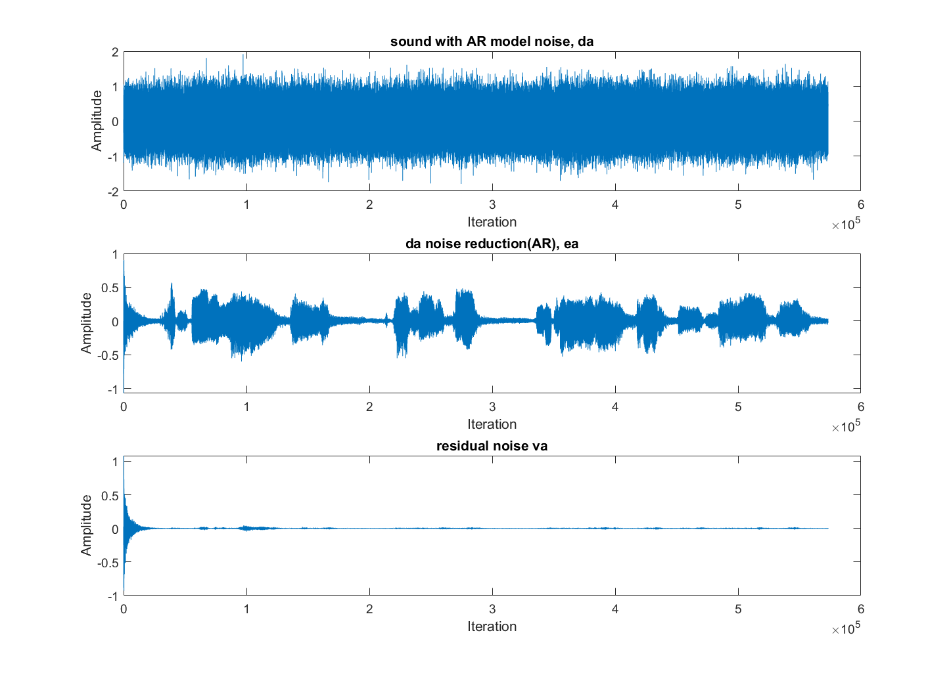
ECE6880 Project
Audio Adaptive Noise Cancellation Using LMS Algorithm
Zeyu Liu

Slide 2
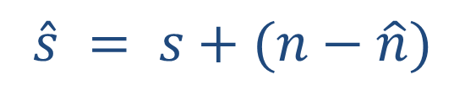


The usual method of estimating noisy signal
s + n
Filter
$$\hat{s}$$
+
∑
s + n
$$\hat{s} = s+(n−\hat{n})$$
−
$\hat{n}$
n₀
Filter

Slide 3



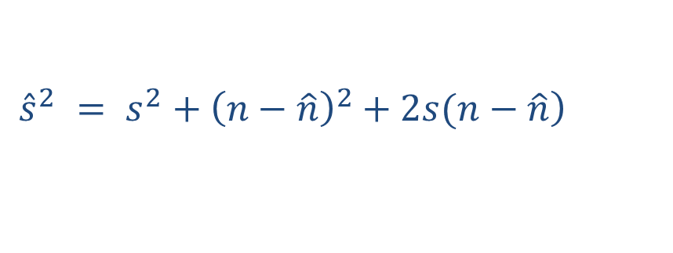

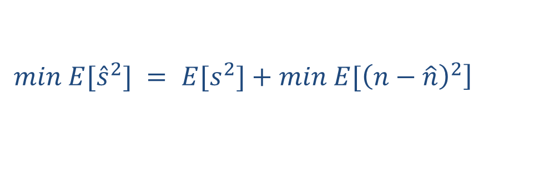


Adaptive Noise Canceller using LMS algorithm
d = s + n
+
e
$$\hat{s}$$
Signal source
∑
error
System output
Primary input
−
y, $\hat{n}$
Filter output
n₀
LMS adaptive filter
Noise canceller
Noise source
FIR adaptive filter
$$\hat{s} = s+(n−\hat{n})$$
Reference input
$$\left.{\hat{s}}^{2} = s^{2}+{\left(n−\hat{n}\right)}^{2}+2s(n−\hat{n}\right)$$
$${E[\hat{s}}^{2}] = E[s^{2}]+E[{\left(n−\hat{n}\right)}^{2}]+2E[s(n−\hat{n})]$$
$s$ is uncorrelated with $n$ and $\hat{n}$:
$${E[\hat{s}}^{2}] = E[s^{2}]+E[{\left(n−\hat{n}\right)}^{2}]$$
$$\left.{min E[\hat{s}}^{2}] = E[s^{2}]+min E[{\left(n−\hat{n}\right)}^{2}\right]$$
$$\hat{s}−s = n−\hat{n}$$

Slide 4
The simplest LMS algorithm
1.Weights evaluation:
$$y(n) = {\hat{w}}^{H}(n)u(n)$$
2.Estimation error (In this project, error is the desired output):
$$e(n) = d(n)−y(n)$$
3.Filter output:
$$\hat{w}(n+1) = \hat{w}(n)+μu(n)e^{∗}(n)$$

Slide 5
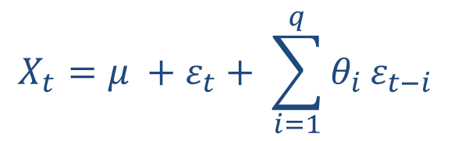
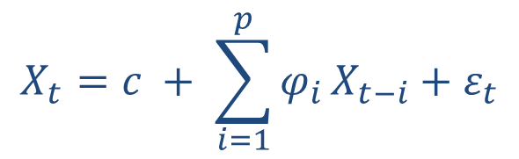


AR model
$$X_{t}=c + \sum_{i=1}^{p}{φ_{i}}X_{t−i}+ε_{t}$$
$ε_{t}$: white noise
AR model describes the relationship between current and historical values.
MA model
$$X_{t}=μ +ε_{t}+ \sum_{i=1}^{q}{θ_{i}}ε_{t−i}$$
$ε_{t}$: white noise
MA model describes the error accumulation of the autoregressive part.

Slide 6
Listening Time
USE MATLAB TO SHOW THE PLOT AND SOUND

Slide 7
M = 10 | Step size µ | iterations | MSE | iterations | MSE | iterations | MSE
 | 0.001 | 200 | 2.4945 | 15000 | 0.0373 | 50000 | 0.0112
 | 0.005 | 200 | 0.5892 | 15000 | 0.0079 | 50000 | 0.0024
 | 0.1 | 200 | 1.0023 | 15000 | 0.0134 | 50000 | 0.0040
µ = 0.005 | taps M | iterations | MSE | iterations | MSE | iterations | MSE
 | 5 | 200 | 1.2461 | 15000 | 0.0116 | 50000 | 0.0050
 | 10 | 200 | 0.5892 | 15000 | 0.0079 | 50000 | 0.0024
 | 30 | 200 | 0.6349 | 15000 | 0.0085 | 50000 | 0.0025

Slide 8
Dhobale, S., Boldhan, V., & Burange, R. A. (2013). Implementation of adaptive noise canceller using lms algorithm. In National Conference on Innovative Paradigms in Engineering & Technology.
Mills, T. (1990). Time series techniques for economistscambridge university press. Cambridge et al, 52, 68.
Ross, L., & Russ, J. C. (2011). The image processing handbook. Microscopy and Microanalysis, 17(5), 843.
Chhikara, J., & Singh, J. (2012). Noise cancellation using adaptive algorithms. International Journal of Modern Engineering Research, 2(3), 792-795.
Singh, A. (2001). Adaptive noise cancellation. Dept. of Electronics & Communication, Netaji Subhas Institute of Technology, 1.
Singh, G., Savita, K., Yadav, S., & Purwar, V. (2013). Design of adaptive noise canceller using lms algorithm. International Journal of Advanced Technology & Engineering Research (IJATER), 3(3), 85-89.
Thakkar, V. (2017). Noise Cancellation using Least Mean Square Algorithm. International Journal of Engineering Research and Application, 7(10), 46-57.
Avalos, J. G., Espinobarro, D., Velazquez, J., & Sanchez, J. C. (2009, August). Adaptive Noise Canceller using LMS algorithm with codified error in a DSP. In 2009 52nd IEEE International Midwest Symposium on Circuits and Systems (pp. 657-662). IEEE.
Dhobale, S., Boldhan, V., & Burange, R. A. (2013). Implementation of adaptive noise canceller using lms algorithm. In National Conference on Innovative Paradigms in Engineering & Technology.
REFERENCES

Slide 9
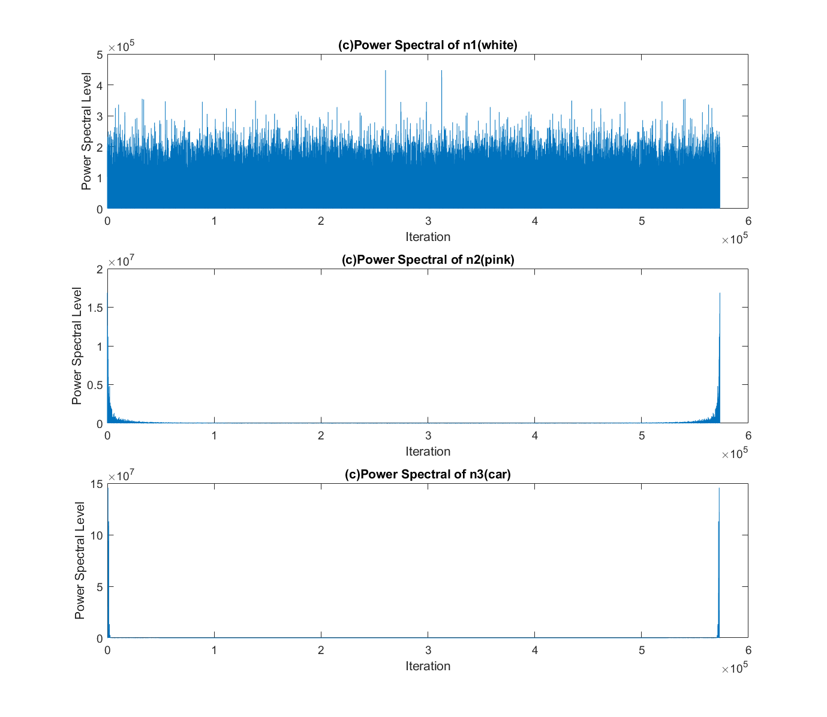
Thank you!
Audio Adaptive Noise Cancellation Using LMS Algorithm
designed: Zeyu Liu

